Slide 1
UNIVERSITY EXPLORER
TEAM MEMBERS:
NUNNA YUKTHA SRI - 23MH1A05N8
NALLAMILLI CHANDRIKA - 23MH1A05N5
DUVVA BALA HARSHITHA KUMARI - 23MH1A05S5
CSE
ADITYA COLLEGE OF ENGINEERING AND TECHONOLGY

Slide 2
INTRODUCTION
Brief About the Organization:
Our project, University Explorer, was developed as part of our academic internship program. The objective of this internship is to provide students with hands-on experience in real-world software development using modern cloud technologies.
Area/Domain of the project :
Focused on serverless architecture and deployment using AWS services (S3, Lambda, API Gateway).
Provided a platform to work on a practical problem statement and deliver a working solution.
Helped students learn secure development practices through IAM roles and policies.
Encouraged teamwork, innovation, and end-to-end project deployment experience.

Slide 3
Problem Statement:
Students often face difficulty in finding universities based on the state they are interested in. Information is scattered across multiple websites, which makes the search process time-consuming and confusing. There is no single, centralized platform that allows students to quickly get accurate and complete state-wise university details. This leads to frustration and delays in decision-making, highlighting the need for a simple, fast, and reliable solution.
Problem Objectives:
Build a centralized platform to search universities by state.
Provide a clean and easy-to-use interface for students.
Use AWS S3 for hosting, Lambda for backend, and API Gateway for connection.
Ensure quick responses and handle errors smoothly.
Make the solution scalable so more states, courses, and details can be added later.
Learn and apply real-world cloud development skills during the project.

Slide 4
Methodology / Approach
Tools, technologies, and frameworks used:
Frontend:
HTML, CSS, JavaScript – For designing and building the web interface.
Backend:
AWS Lambda (Python) – For serverless processing of search requests.
API Gateway – To connect frontend with backend securely.
Hosting & Storage:
AWS S3 – For hosting the static website.
Security & Access Control:
AWS IAM Roles & Policies – For secure Lambda execution and API access.

Slide 5
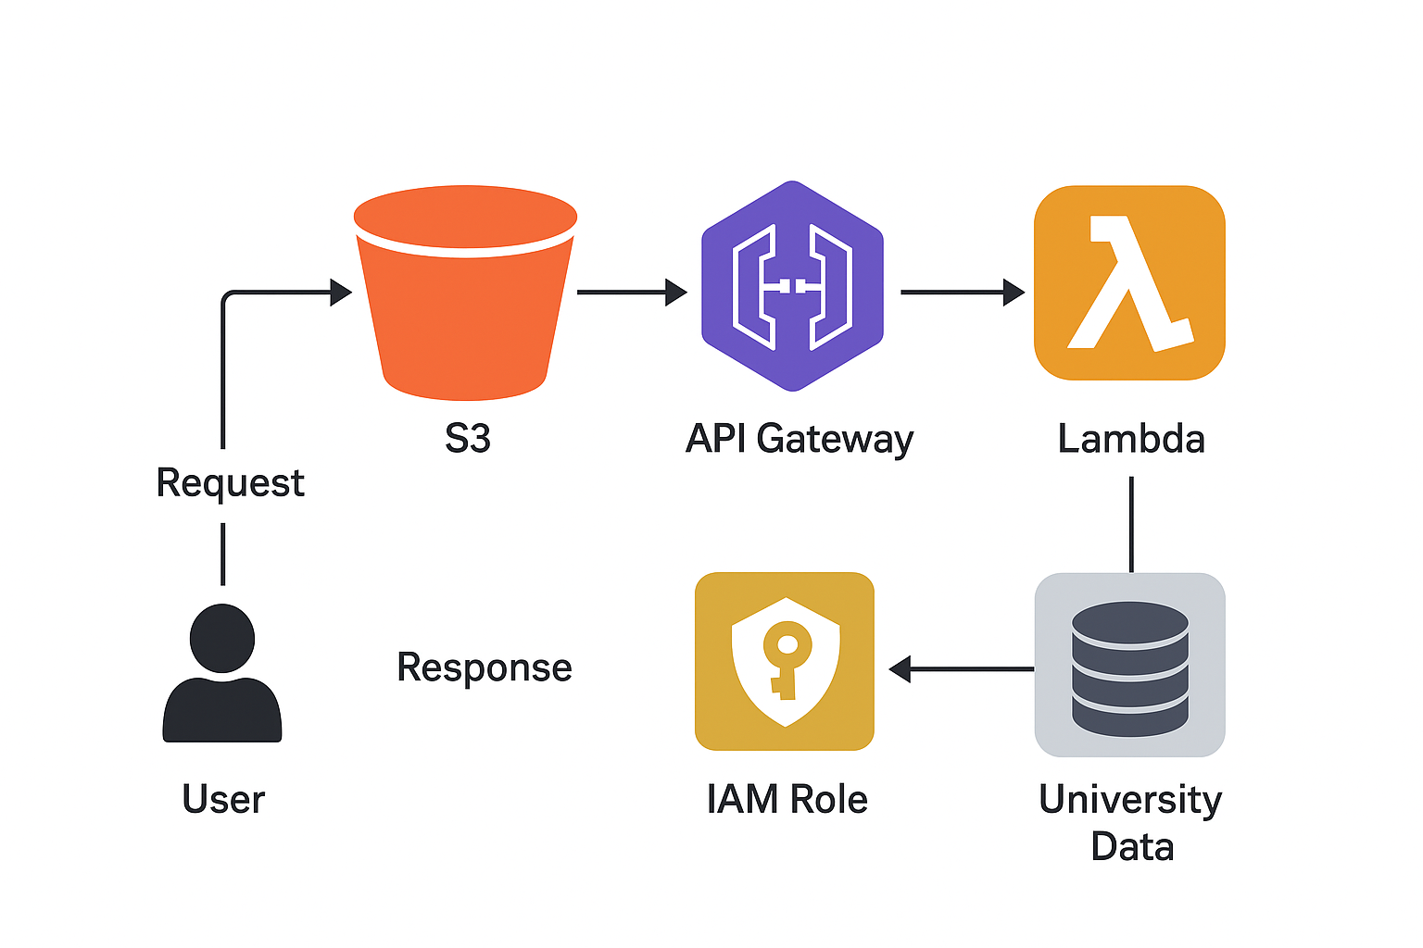
System architecture:

Slide 6
Work Flow:
User enters a state name in the search box and clicks Search.
Frontend (S3 Website) sends a request to API Gateway.
API Gateway forwards the request to the Lambda Function.
Lambda Function fetches matching university data from the data source (JSON/DB).
IAM Role ensures Lambda has secure access to resources.
Lambda Function sends response back to API Gateway.
API Gateway returns data to the Frontend.
Frontend displays results neatly to the user.

Slide 7
Step-by-Step Project Implementation
1. Frontend Design & Development:
We designed a simple and user-friendly interface using HTML, CSS, and JavaScript.
The UI contains:
→A search bar for entering the state name.
→A button to get results.
→ A list area to display universities.
We first made a basic UI, then improved it with colors and better design.

Slide 8
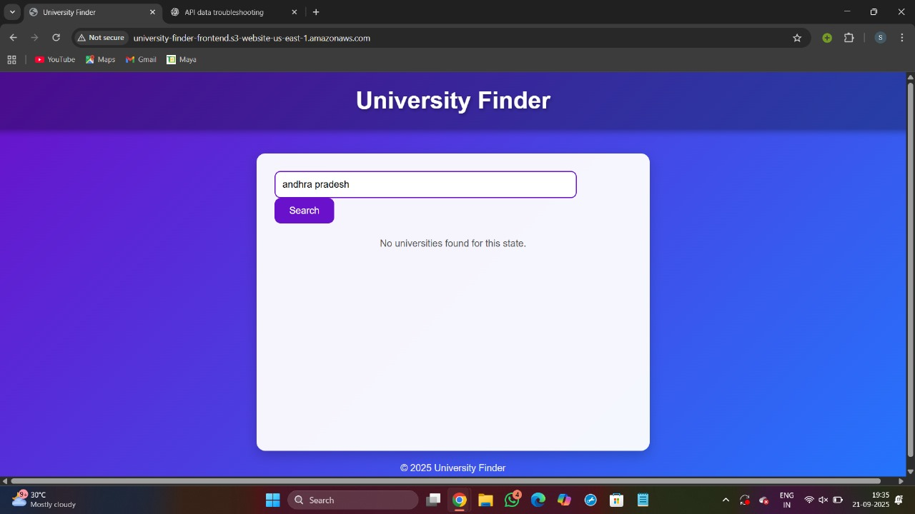
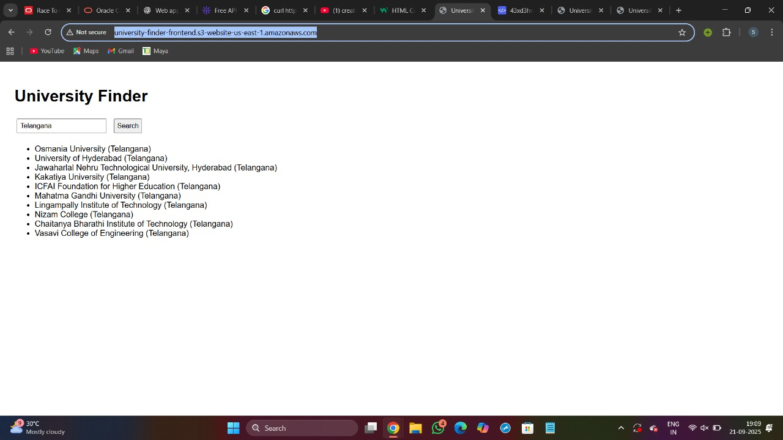

Slide 9
2. Backend Development with Lambda:
We wrote a Python function to store universities state-wise and return results.
We deployed it on AWS Lambda so it runs only when needed (serverless).
We tested it using sample inputs to make sure the data is correct.

Slide 10
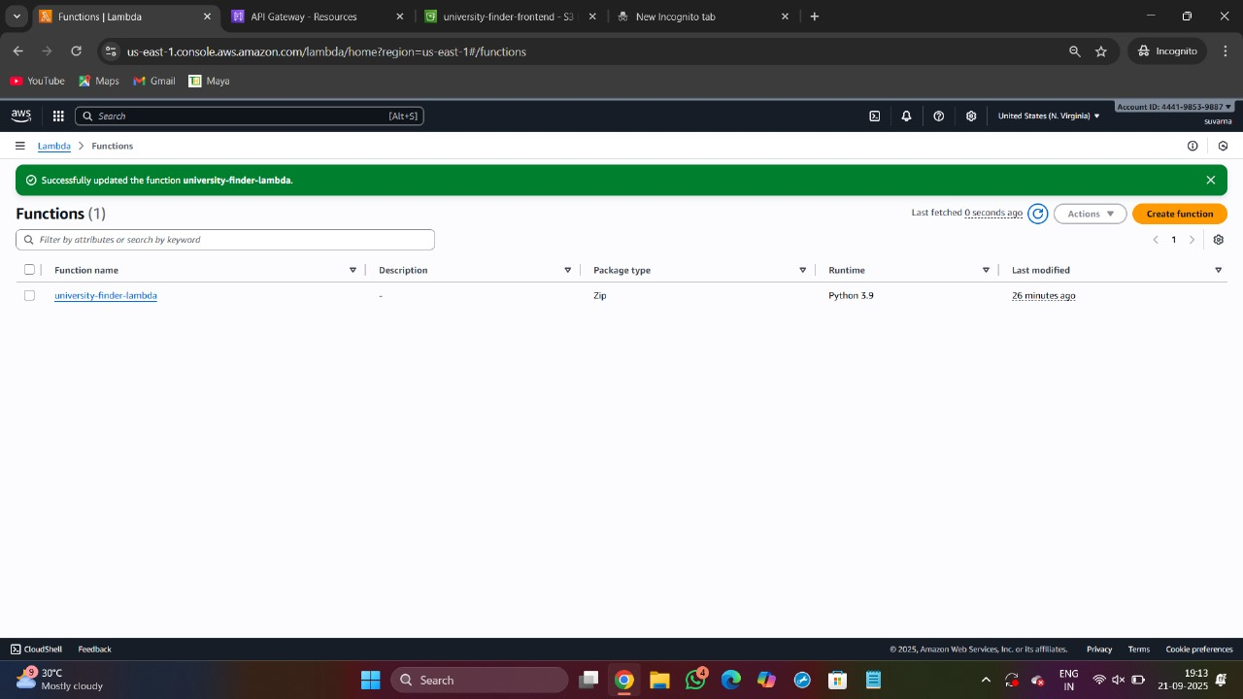
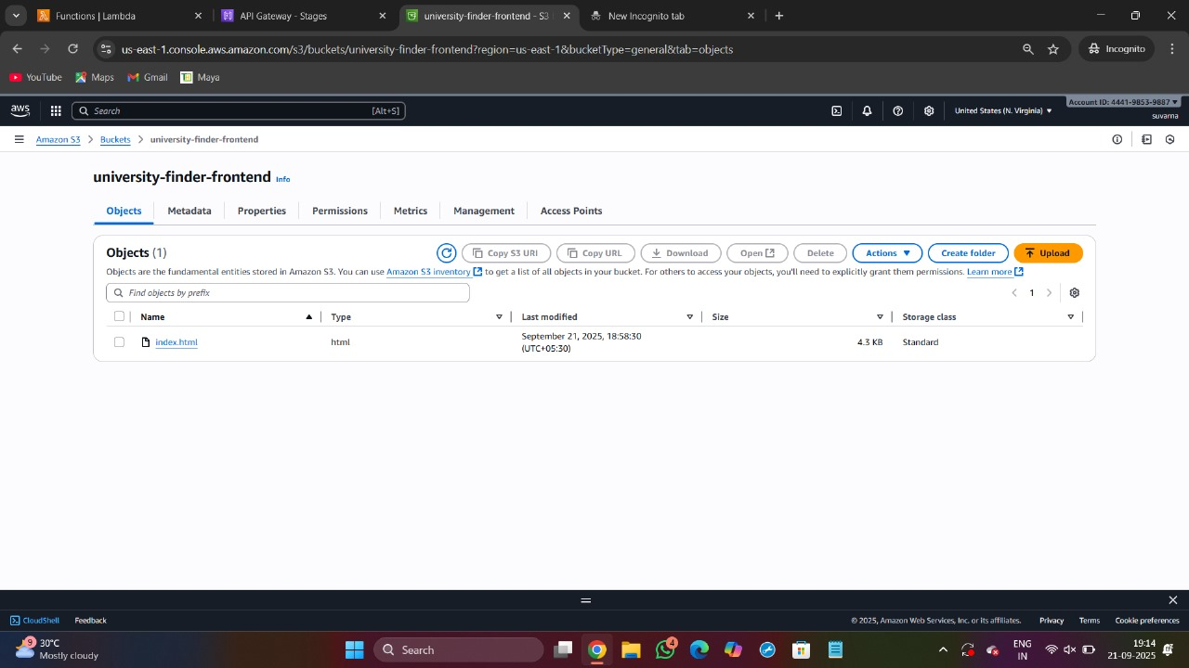

Slide 11
3. API Gateway Setup:
We created an API Gateway to connect the frontend with Lambda.
We used POST method for searching universities.
Deployed API to a Prod Stage and got the Invoke URL to use in frontend code.

Slide 12
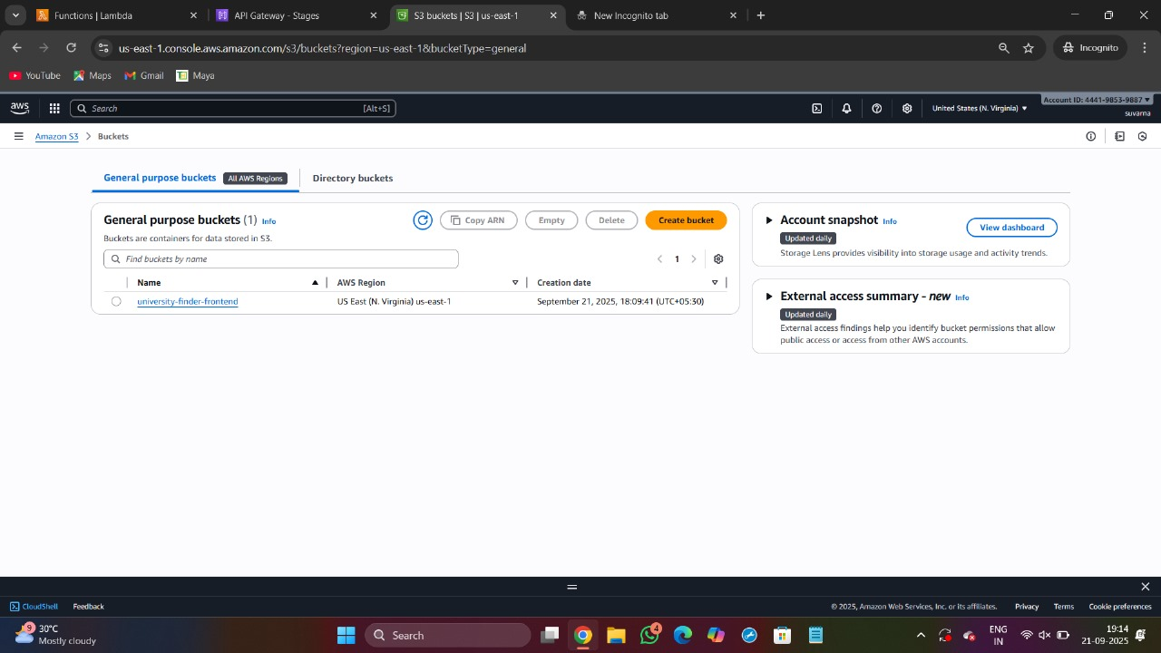
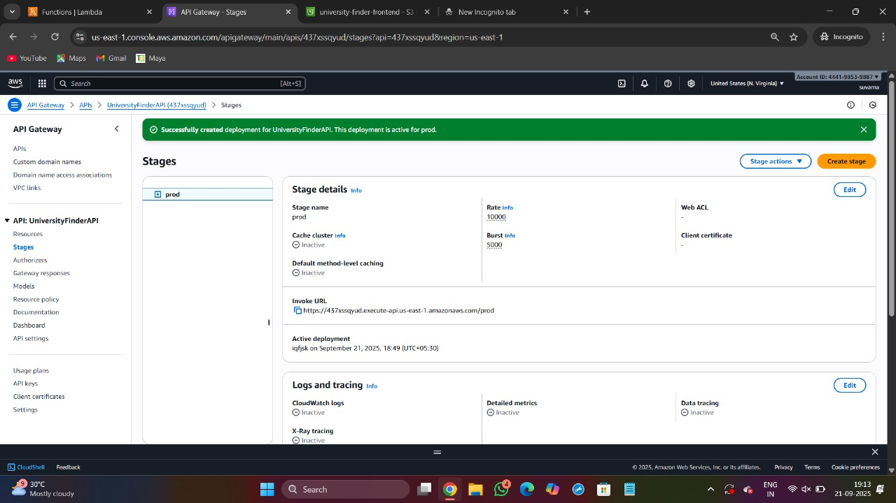

Slide 13
4. IAM Role & Policy Setup:
Created an IAM Role to give Lambda permission to run.
Attached basic execution policy so Lambda can write logs.
Ensured security by allowing only required services to access.

Slide 14
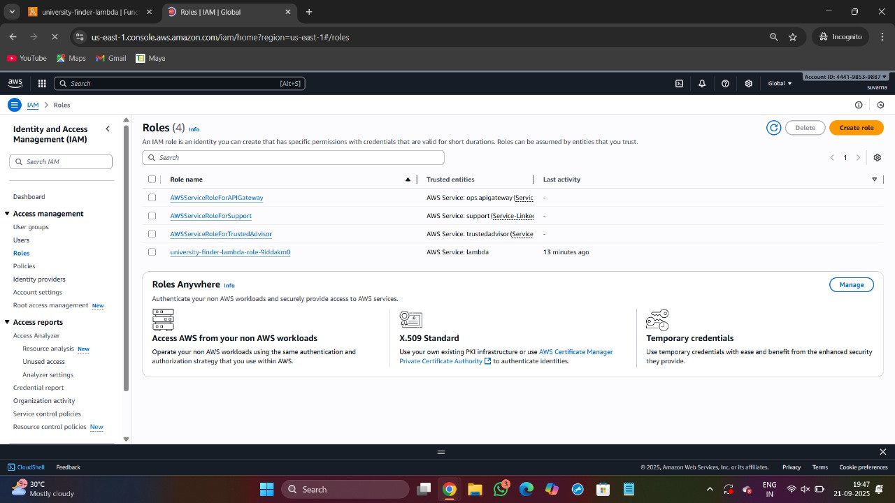
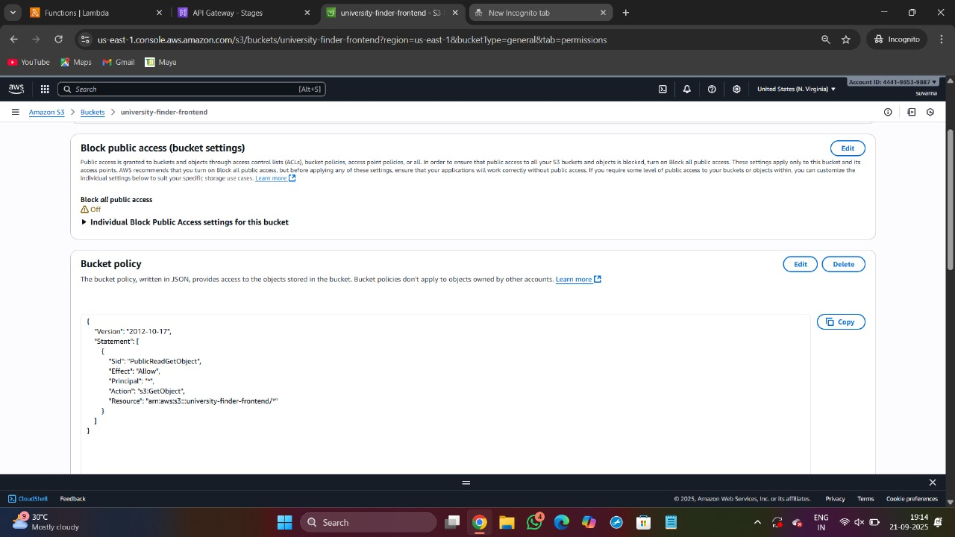

Slide 15
5. Hosting Frontend on S3:
Created an S3 bucket to host frontend files.
Uploaded index.html, CSS, JS files.
Enabled static website hosting and allowed public access.

Slide 16
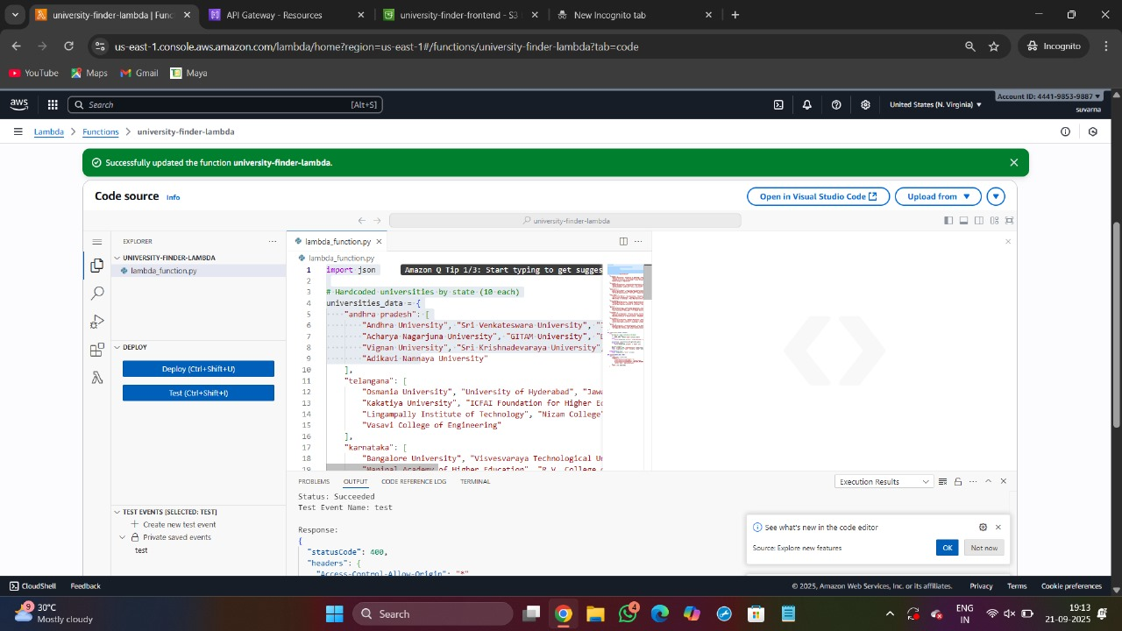
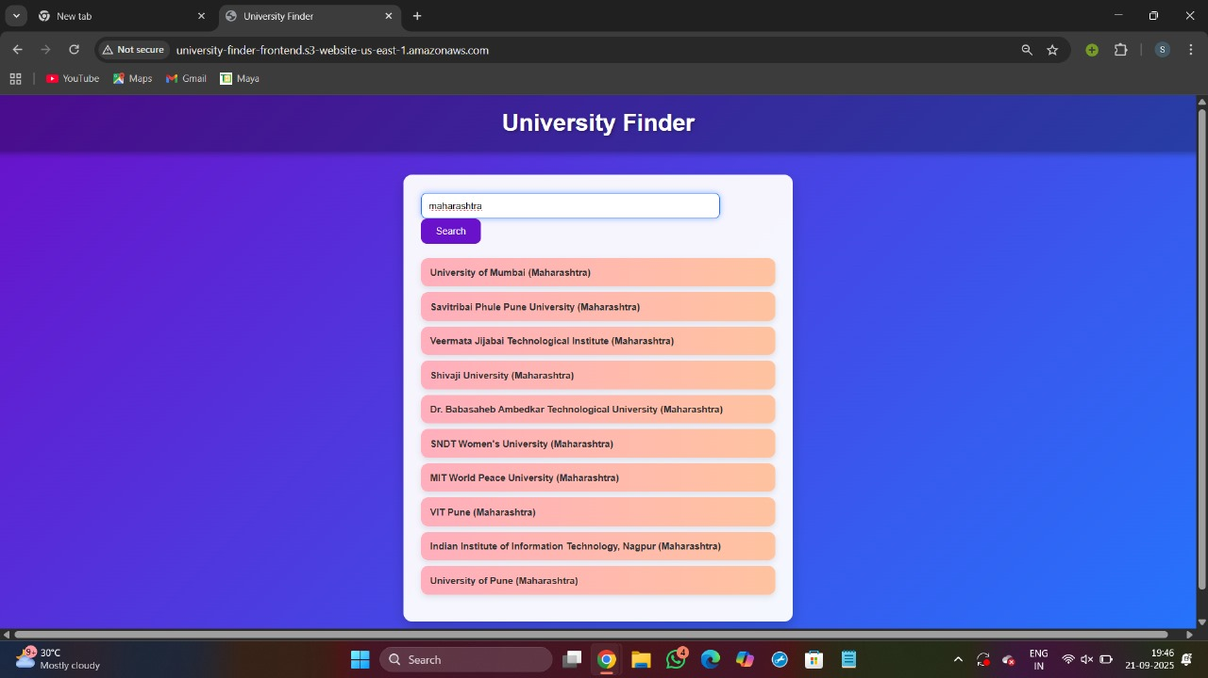

Slide 17
6. Testing and Debugging:
We tested using CloudShell and cURL commands first.
Verified API response and fixed CORS errors.
Tested for multiple states: Telangana, AP, Karnataka, Tamil Nadu.

Slide 18
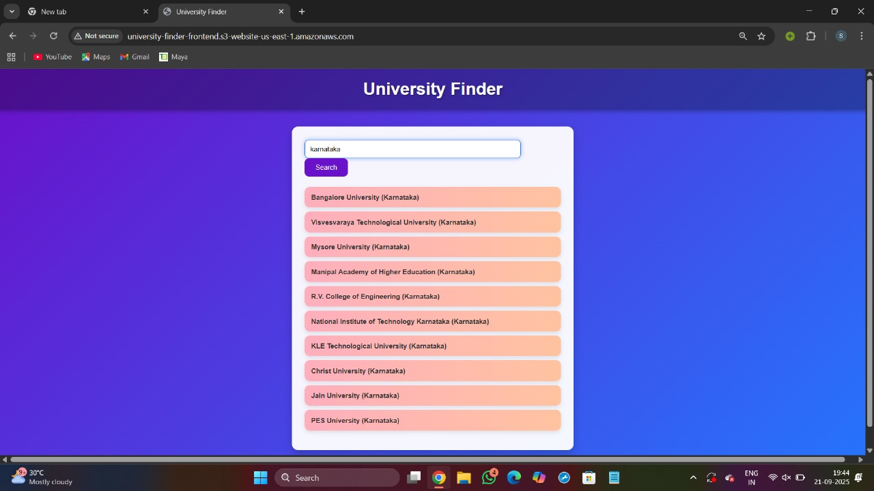
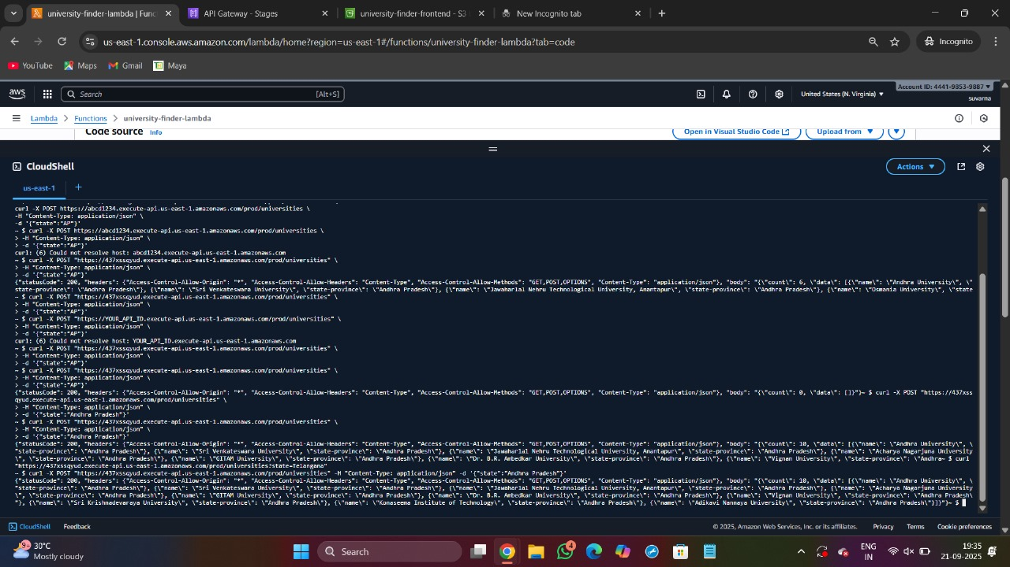


Slide 19
7. Final Deployment:
Uploaded updated frontend to S3.
Verified that everything works on the public URL.
Final UI is colorful, clean, and user-friendly.

Slide 20

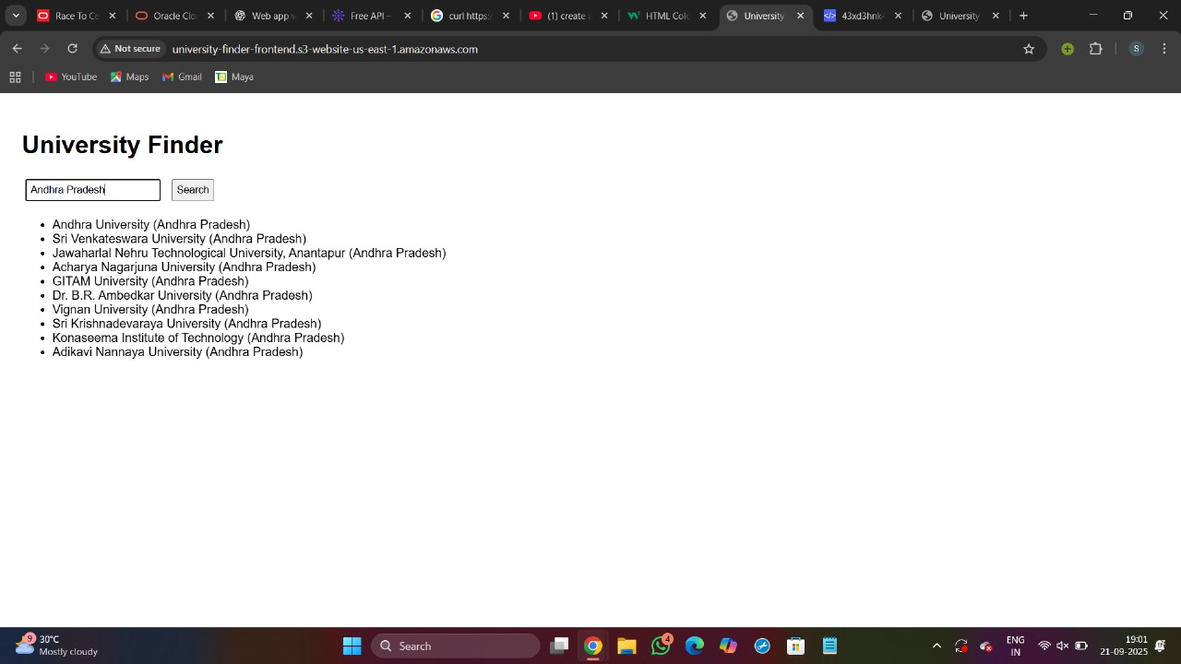
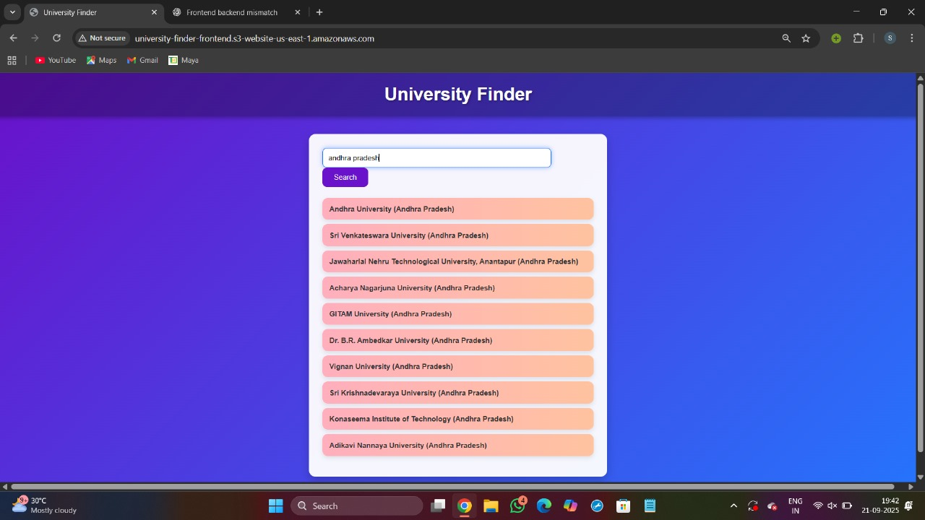

Slide 21
Output obtained:
Successfully developed a University Finder Web App hosted on AWS.
User can search universities by state and get instant results.
The system works smoothly with real-time response from Lambda function.
We tested for multiple states:
→Telangana – displaying 10 universities
→Andhra Pradesh – displaying 14universities
Final UI is clean, colorful, and easy to use.

Slide 22
Challenges Faced:
Faced CORS errors while connecting frontend with API Gateway → fixed by enabling CORS.
Lambda permissions issue → solved by attaching correct IAM Role & Policy.
API URL mismatch → updated frontend JavaScript with correct URL.
Wrong JSON format → corrected data inside Lambda function.
S3 access problem → fixed by setting proper bucket policy and enabling public access.
Future Scope:
Add more details like courses, fees, rankings, and city filters.
Connect to a real-time database or API for updated university data.
Deploy with a custom domain and SSL for a professional look.

Slide 23
CONCLUSION:
Our project, University Finder, was successfully developed using AWS serverless services like S3, Lambda, API Gateway, and IAM. It allows students to search for universities state-wise and get results instantly in a clean and user-friendly interface. Through this project, we gained hands-on experience in designing, implementing, and deploying a real-world cloud-based application. The solution is scalable and can be enhanced further by adding more data, filters, and features in the future.

Slide 24
THANKYOU

